Slide 1

Mini Project-I (K24MCA18P) Odd Semester Session 2024-25
Smash The Hunger
Zeeshan Malik - 2426MCA846
Syed Zaid Ashraf - 2426MCA712
Suhel Saifi – 2426MCA207
Project Supervisor:
Divya Singhal
Asst. Professor

Slide 2
Content
Introduction
Literature Review
Objective of the Project
Technology
Hardware Requirements
Software Requirements
Modules
Workflow
Reports
References
Notes:
Font Styles: Times New Roman + Font Size: 25

Slide 3
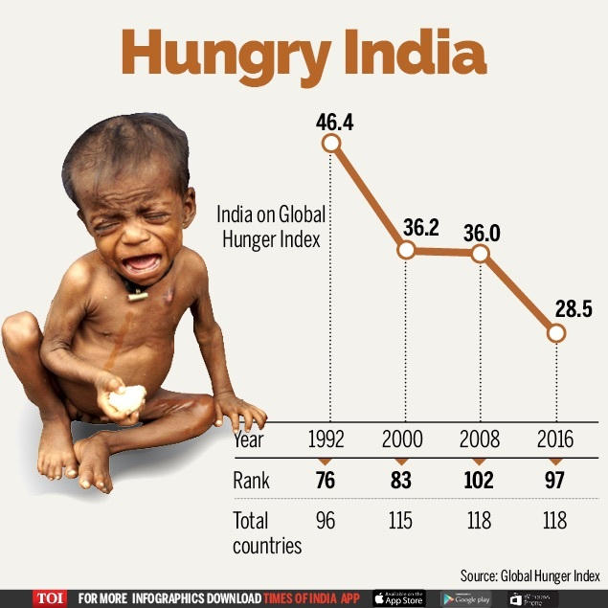
Introduction
Smash The Hunger (STH) dedicated to addressing two critical issues: food waste and food insecurity. STH mobilizes NGOs and college students across India to recover surplus food from dining facilities, restaurants, and local businesses, redirecting it to those in need through food banks and community organizations.
In India, it is estimated that around 67 million metric tons of food is wasted annually. This staggering figure represents approximately 35-40% of the total food produced in the country.
STH aims to provide meals to individuals facing food insecurity and reduce the food wastage.
Notes:
Font Styles: Times New Roman + Font Size: 25

Slide 4
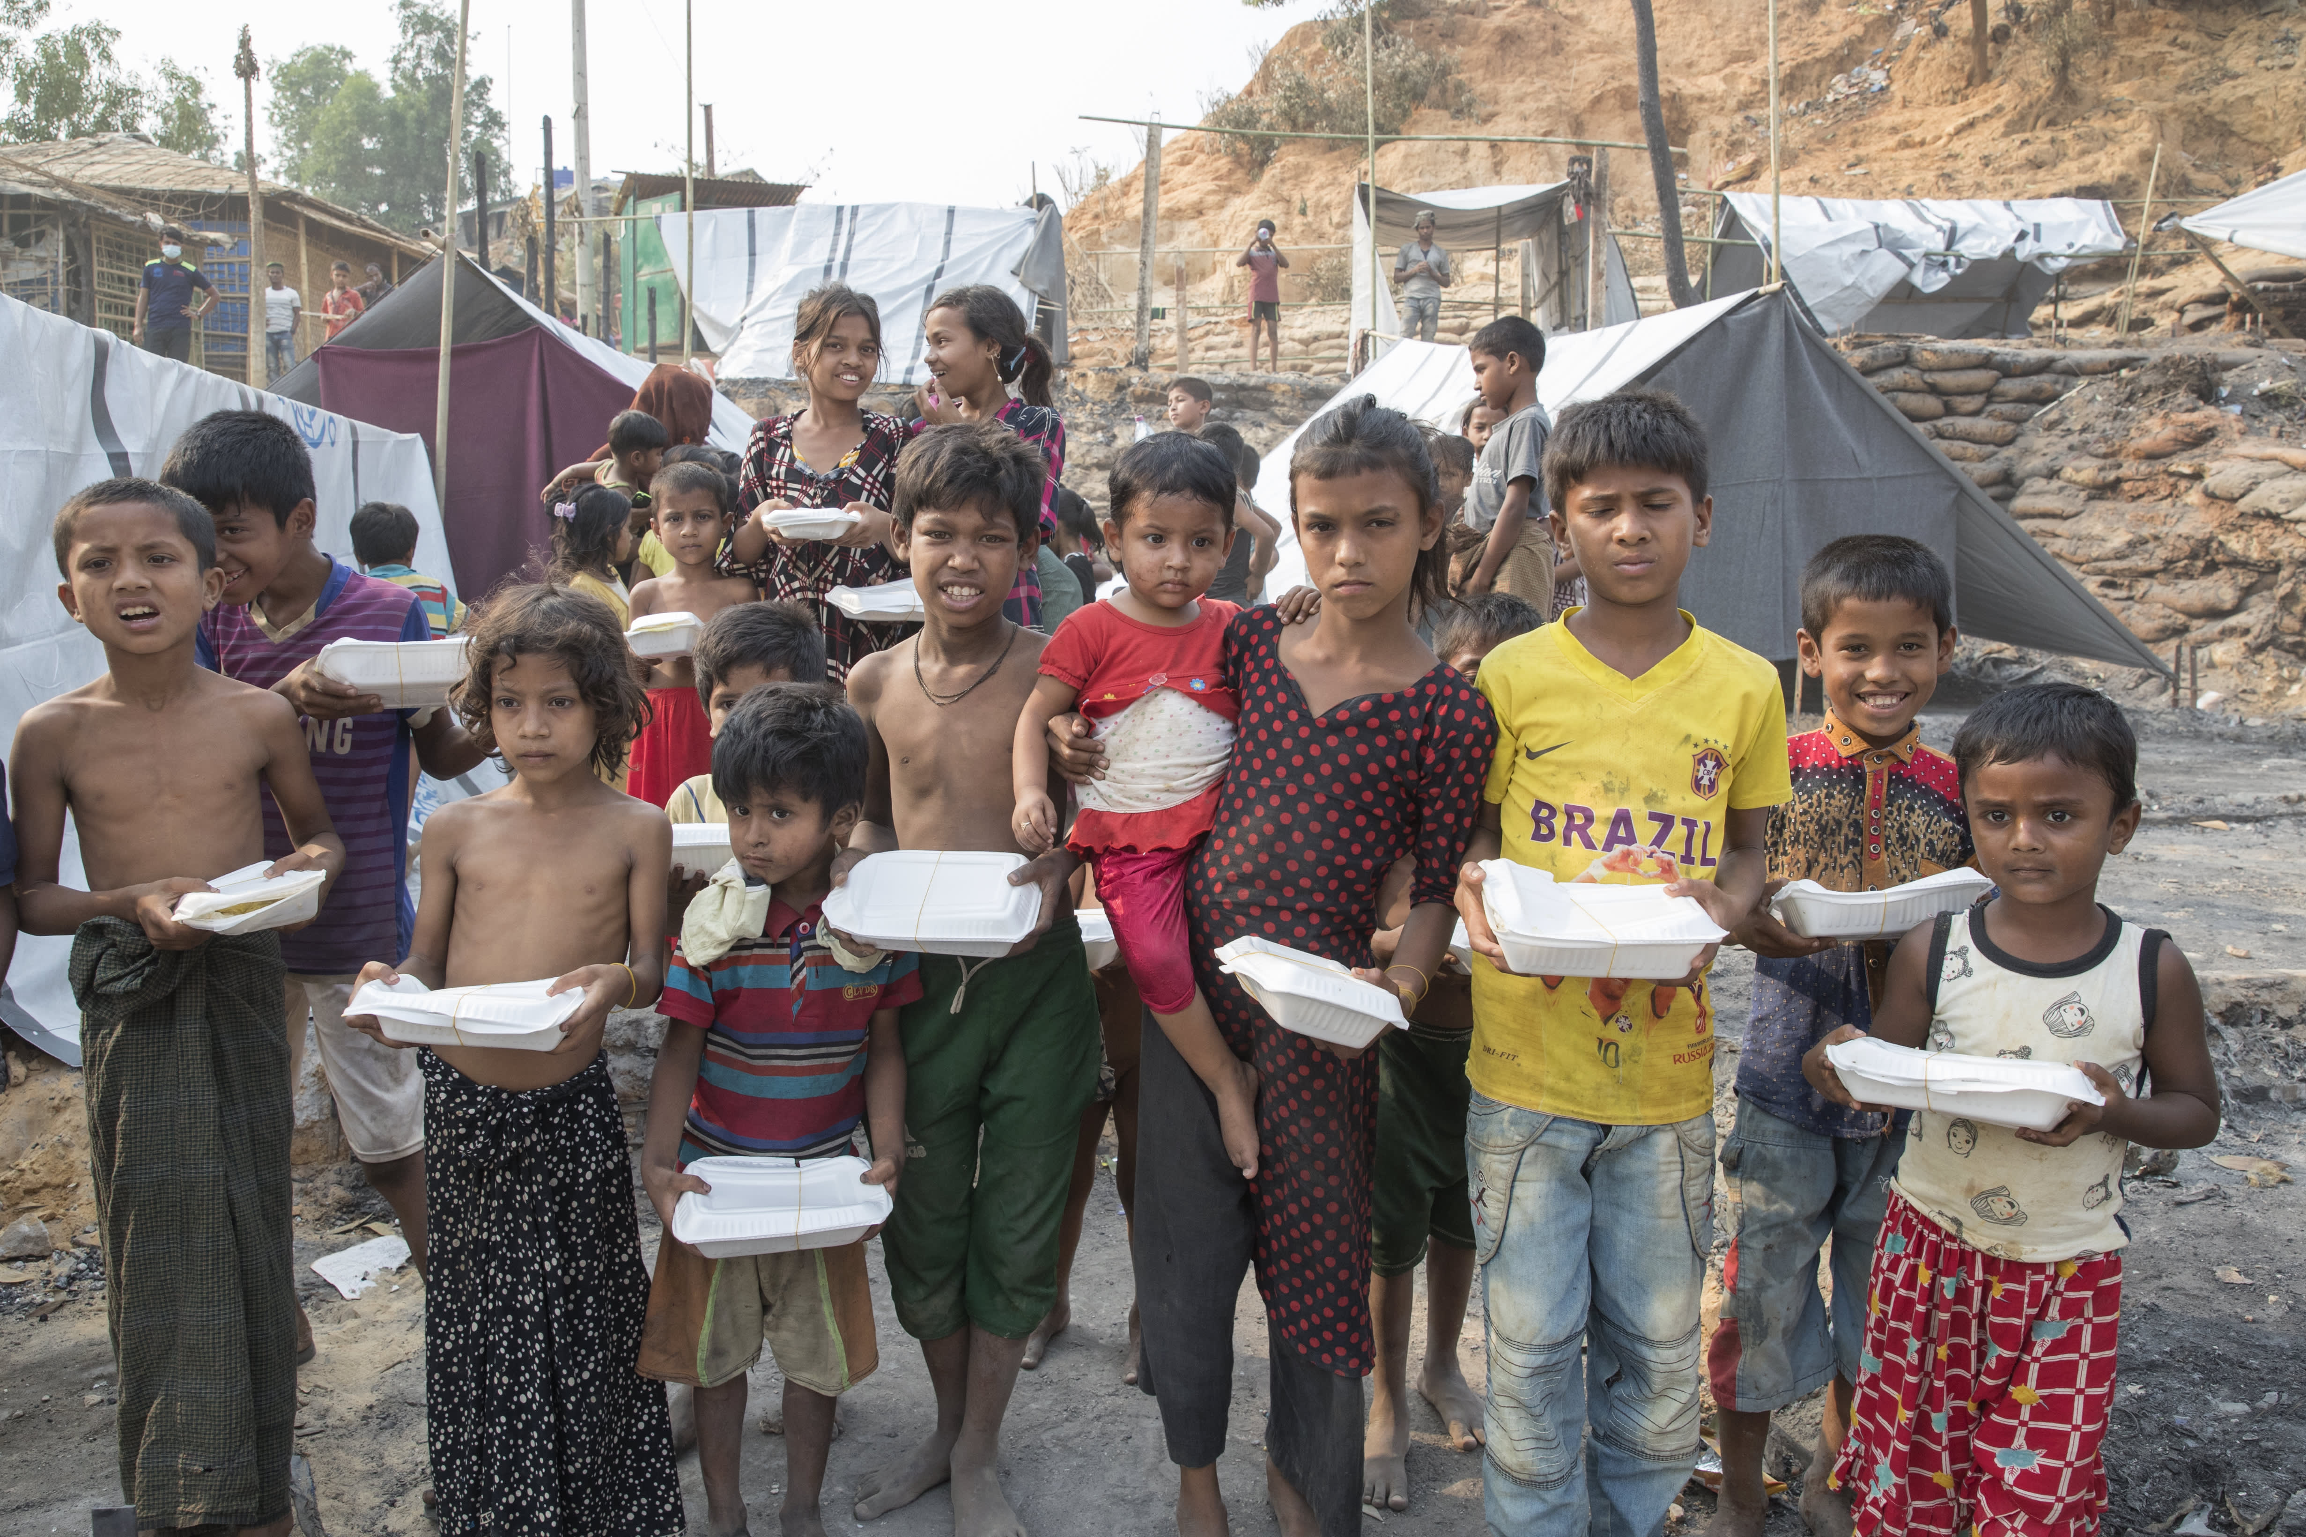
Literature Review
Reduce Food Waste - Partner with restaurants, local businesses, and caterers to establish regular food donation programs. This can include daily pickups of surplus food that would otherwise go to waste.
Addressing Food Insecurity - Support Vulnerable Communities: By redistributing recovered food, STH seeks to provide nutritious meals to individuals and families facing food insecurity, improving access to food for those in need.
Community Engagement and Student Involvement -The STH model empowers students by involving them in hands-on service and leadership opportunities. This engagement not only raises awareness but also cultivates future leaders committed to sustainability and social equity.
Notes:
Font Styles: Times New Roman + Font Size: 25

Slide 5
Literature Review (Contd.)
Best Practices and Recommendations -
Building strong partnerships with local businesses and food banks.
Utilizing technology to streamline logistics and improve tracking of recovered food.
Providing ongoing training for volunteers and staff to ensure successful implementation.
Conclusion - Smash The Hunger represents a critical response to the dual challenges of food waste and food insecurity. By mobilizing students and fostering community partnerships, STH demonstrates the potential for grassroots initiatives to create meaningful change. Continue research and collaboration are essential to overcoming barriers and enhancing the impact of food recovery efforts.
Notes:
Font Styles: Times New Roman + Font Size: 25

Slide 6
Objective of the Project
Reduce Food Waste
Address Food Insecurity
Engage Students and Communities
Raise Awareness and Educate
Foster Collaboration
These objectives collectively contribute to a more sustainable and equitable food system, addressing the interconnected issues of food waste and food insecurity.
Notes:
Font Styles: Times New Roman + Font Size: 25

Slide 7
Technology (Hardware Requirements)
Processor - 1.6 GHz or faster processor
Ram – 4 GB or More
Operating System -
Windows 10 and 11 (64-bit)
macOS versions with Apple security update support. This is typically the latest release and the two previous versions.
Browser – Any Browser
Notes:
Font Styles: Times New Roman + Font Size: 25

Slide 8
Technology (Software Requirements)
Language – HTML, CSS, JS, SQL ,PHP
Framework – Bootstrap
Database – phpMyAdmin
Code Editor – Vs Code
Notes:
Font Styles: Times New Roman + Font Size: 25

Slide 9
Modules
User Roles and Permissions
Donors: Businesses or individuals donating food. They need an easy way to list available items and coordinate pickups.
Recipients: Organizations or individuals receiving food. They may need to track what they receive and provide feedback.
Administrators: Manage the entire system, oversee user management, and ensure compliance and reporting.
User Registration and Profiles
Simple registration processes for volunteers, donors, and recipients.
Profiles that store essential information, such as contact details, availability for volunteers, and types of food donations for donors.
Notes:
Font Styles: Times New Roman + Font Size: 25

Slide 10
Modules (Contd.)
Food inventory management
Inventory Tracking
Real-Time Updates: Use software to track incoming and outgoing food items in real time, helping avoid overstocking or shortages.
Expiration and Quality Control
Expiration Date Tracking: Automatically alert staff about items approaching their expiration dates to prioritize distribution.
Notes:
Font Styles: Times New Roman + Font Size: 25

Slide 11
Reports
Website Traffic:
Total number of visitors
Traffic sources (e.g., search engines, social media, direct traffic)
Page views
Time on site
Donations:
Total number of donations
Average donation amount
Donation trends over time
User Engagement:
Number of registered users
User interactions (e.g., page views, clicks, form submissions)
User feedback and reviews
Impact Analysis
Food Distributed: Quantify the amount of food distributed through the website.
Communities Served: Identify the number and types of communities served by the website.
Positive Outcomes: Highlight stories of individuals or families who have benefited from the website.
Challenges: Identify any obstacles or difficulties encountered in operating the website.
Notes:
Font Styles: Times New Roman + Font Size: 25

Slide 12
References
References
Books:
Food Banks: A Guide to Feeding the Hungry by Andrew Fisher
The End of Hunger: How to Feed the World and Save Our Planet by Erik Millstone and Tim Lang
The Food Donation Handbook by the National Food Bank Council
Feeding America: https://www.feedingamerica.org/
Food Bank Canada: https://foodbankscanada.ca/
Second Harvest Food Bank: https://no-hunger.org/volunteer/
ShareFood: https://www.sharefoodprogram.org/
Notes:
Font Styles: Times New Roman + Font Size: 25

